Slide 1
CNN Deep Learning Project
Jeffery Chan

Slide 2
Intel image classification
contains roughly 25,000 image data
broadly defined under 6 categories
RGB colored images encoded as 3
IMG_WIDTH = 150
IMG_HEIGHT = 150
BATCH_SIZE = 128

Slide 3
Problem statement
How do we, humans, recognize a forest as a forest or a mountain as a mountain? We are very good at categorizing scenes based on the semantic representation and object affinity, but we know very little about the processing and encoding of natural scene categories in the human brain. In this problem, you are provided with a dataset of ~25k images from a wide range of natural scenes from all around the world. Your task is to identify which kind of scene can the image be categorized into.

Slide 4
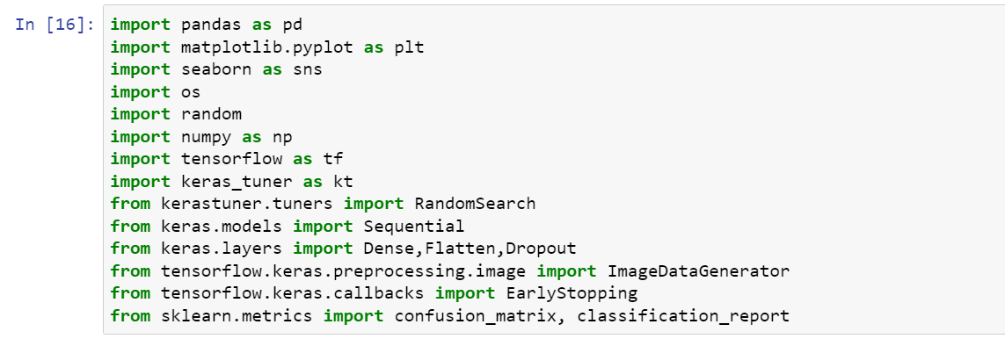
Libraries

Slide 5
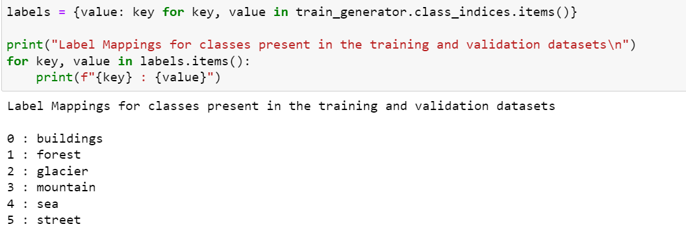
classes

Slide 6
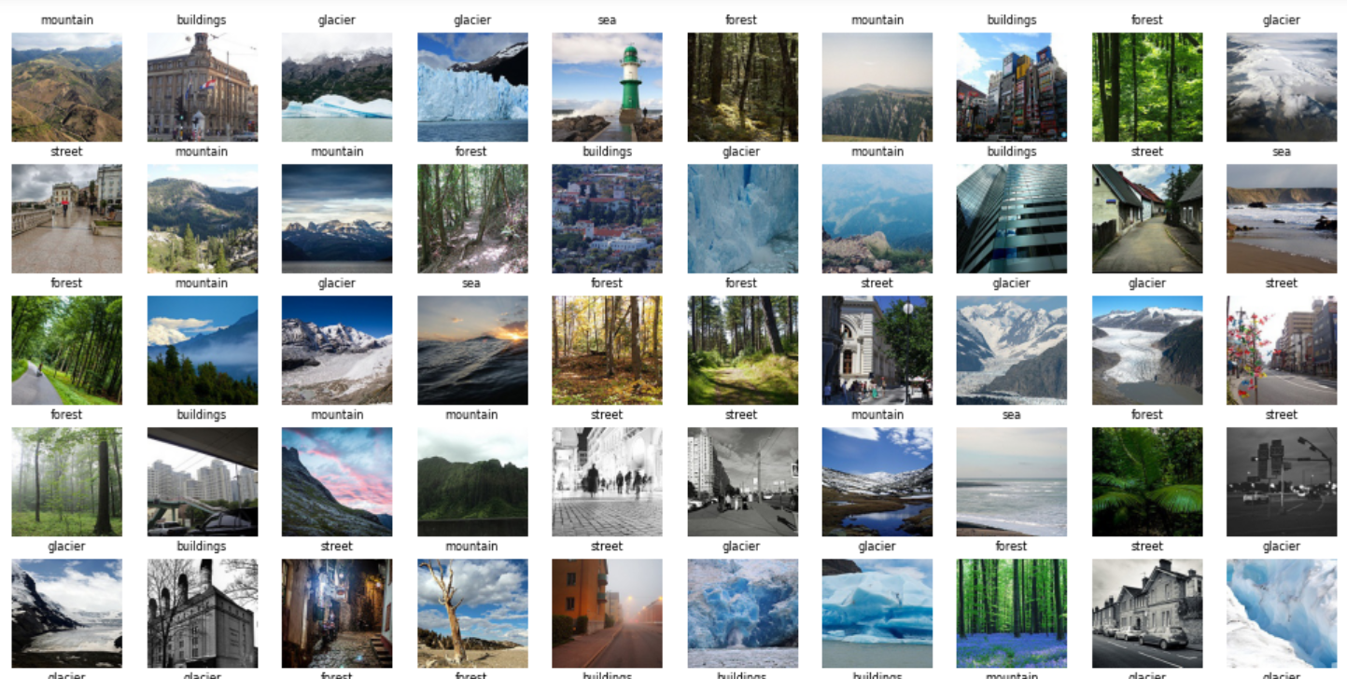
sample plotting

Slide 7
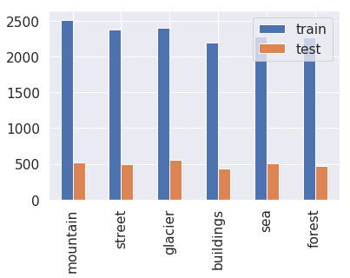
class distribution

Slide 8
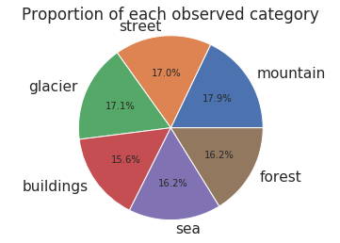
Proportion of classes

Slide 9
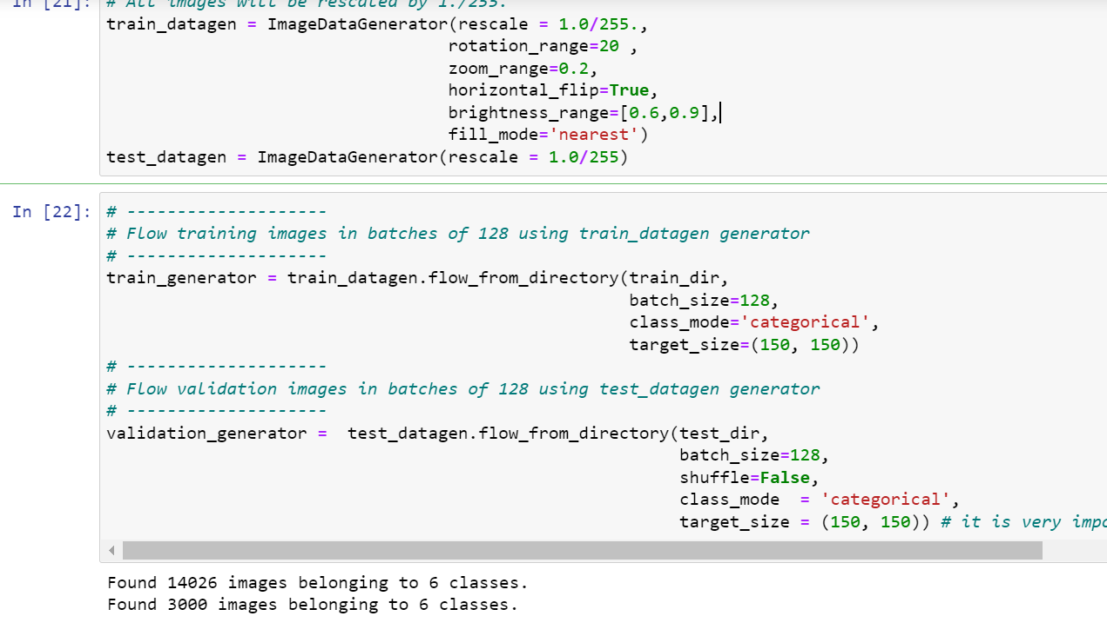
resizing and augmentation

Slide 10
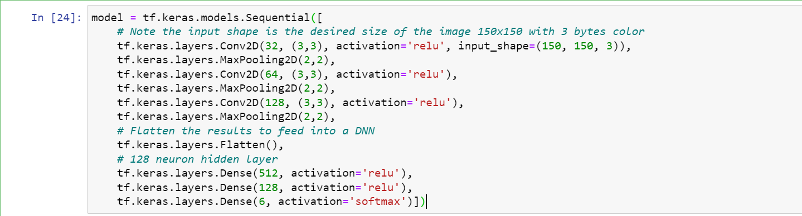
cnn architecture

Slide 11
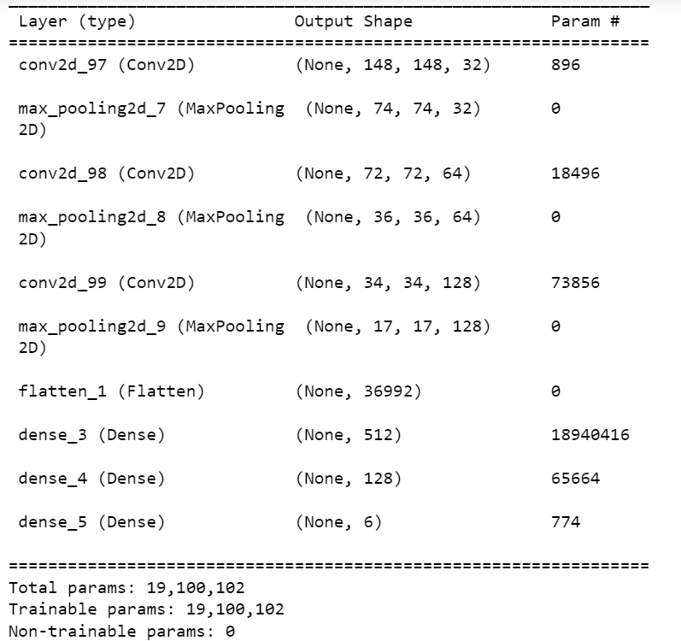
model summary

Slide 12
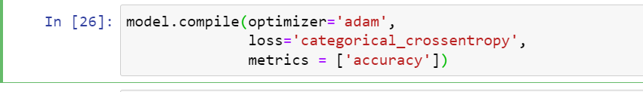
model compile

Slide 13
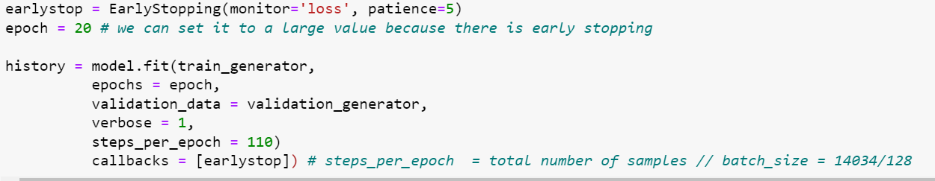
model fit

Slide 14
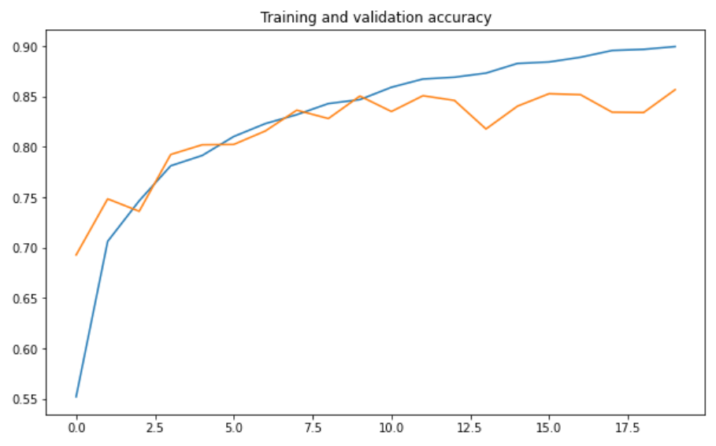
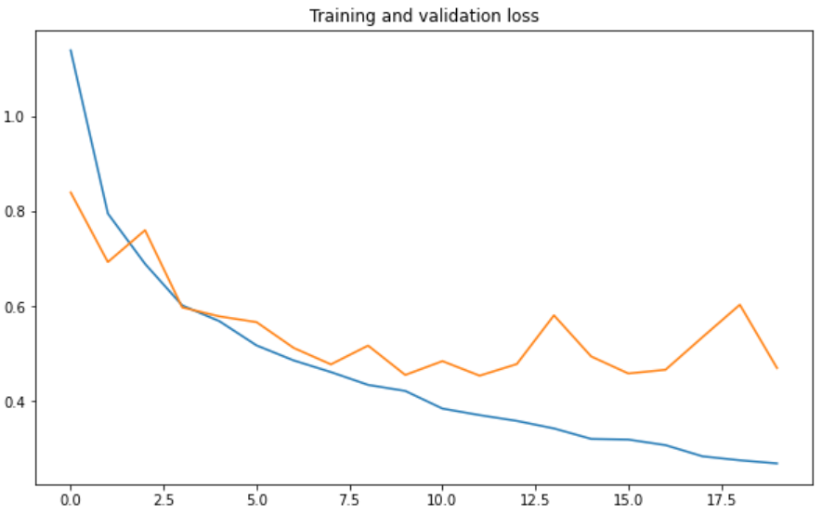
model evaluation

Slide 15
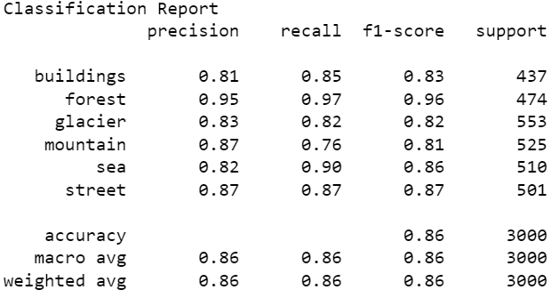
model Evaulation

Slide 16
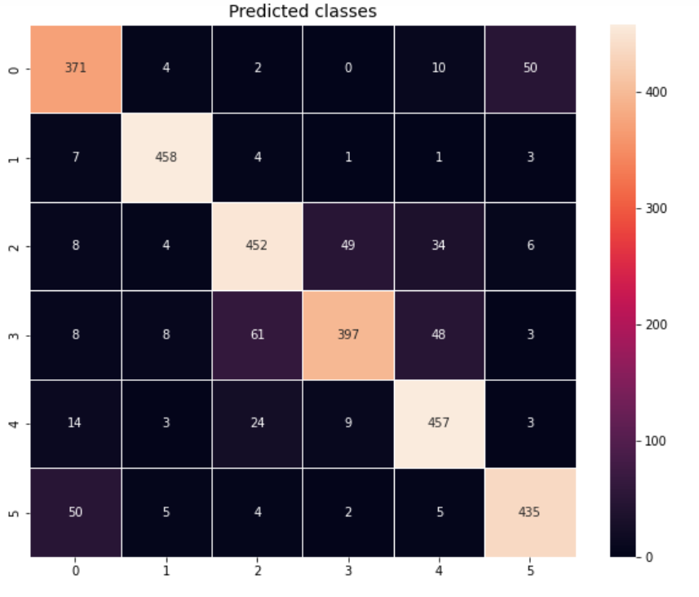
model evaluation

Slide 17
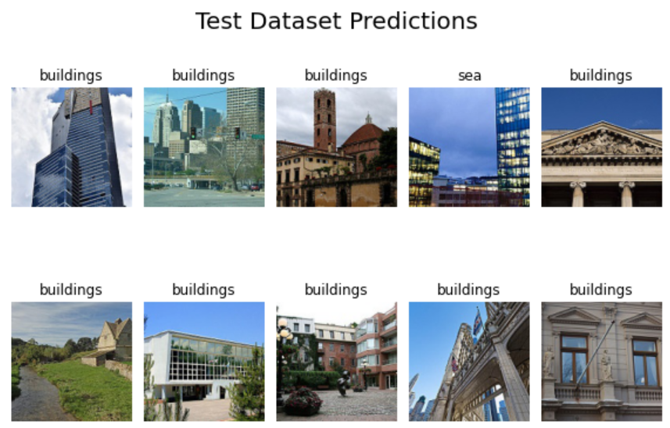
predictions on test set

Slide 18
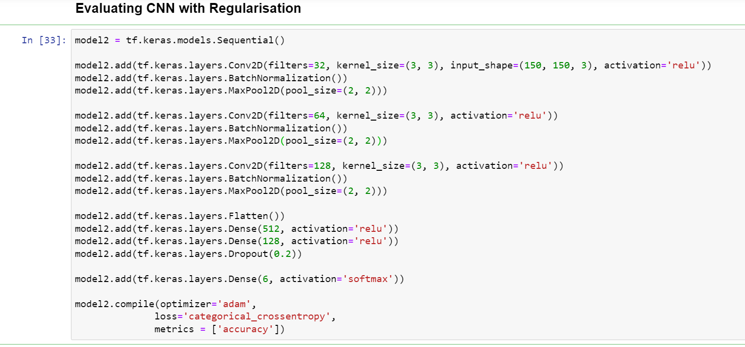
regularisation

Slide 19
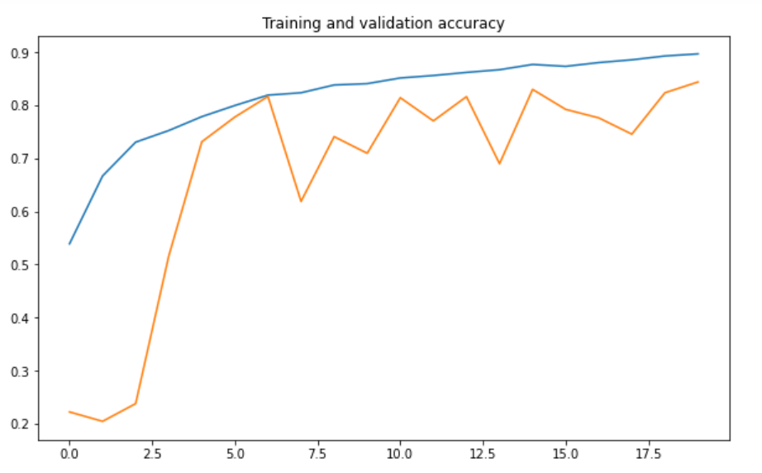
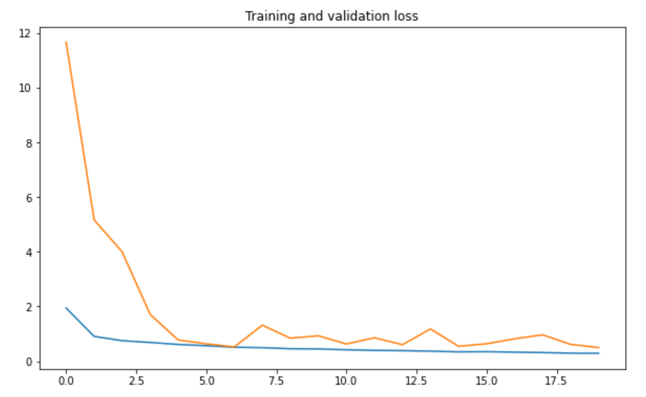
model evaulation

Slide 20
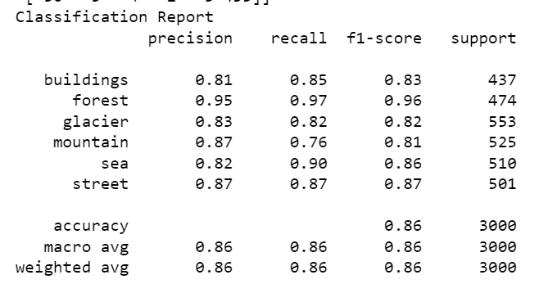
model evaluation

Slide 21
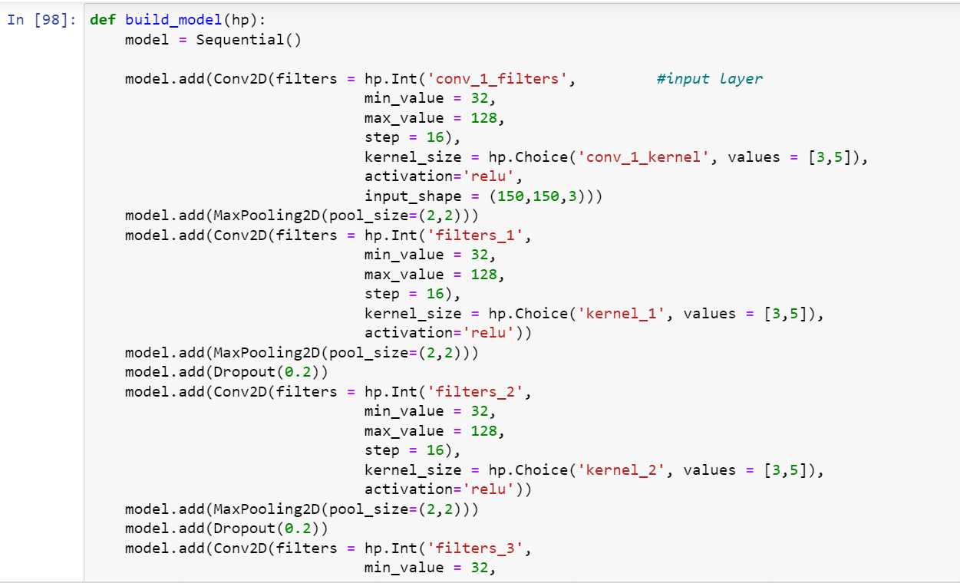
cnn tuning

Slide 22
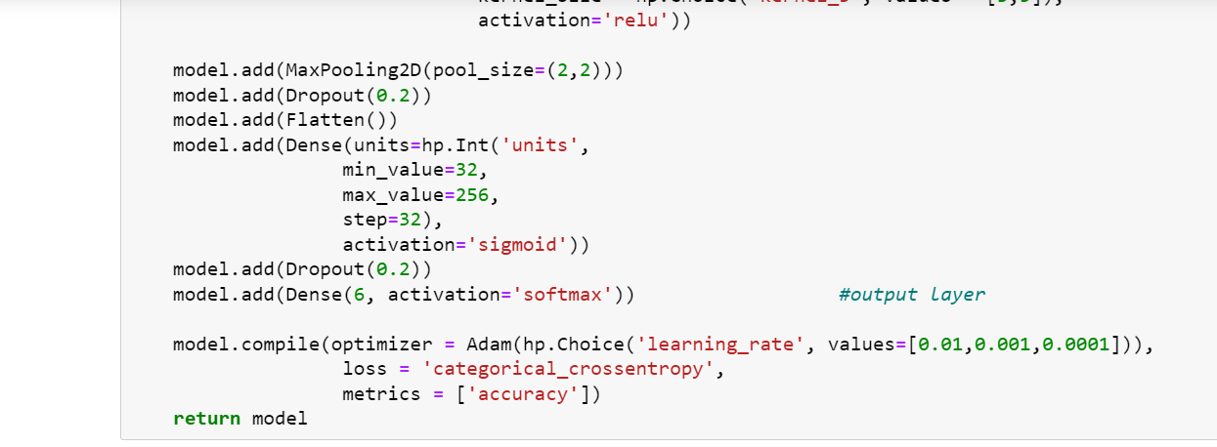
CNN tuning

Slide 23
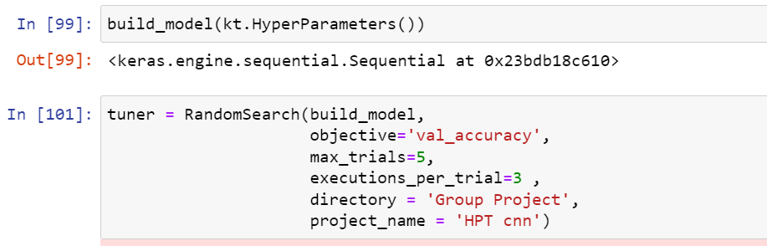
cnn tuning

Slide 24
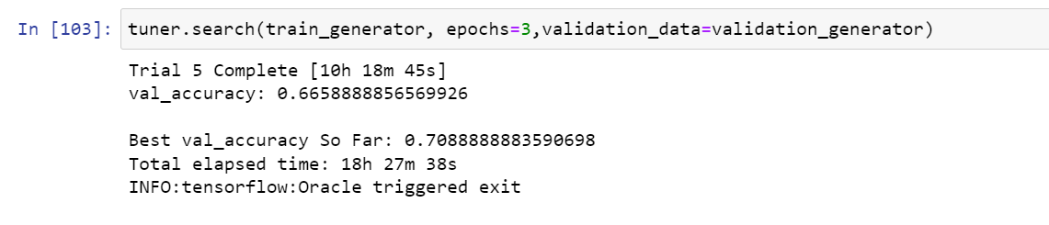
tuning result

Slide 25
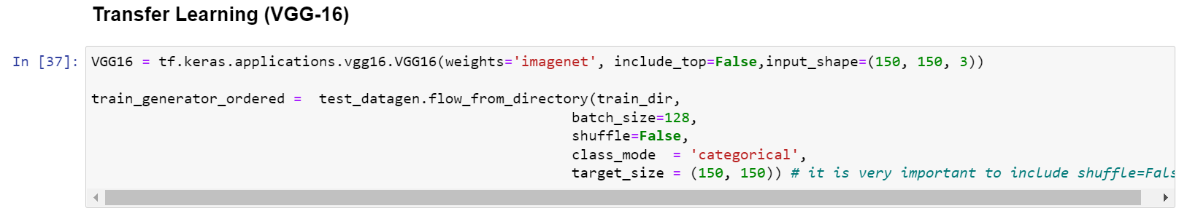
Transfer learning (VGG16)

Slide 26
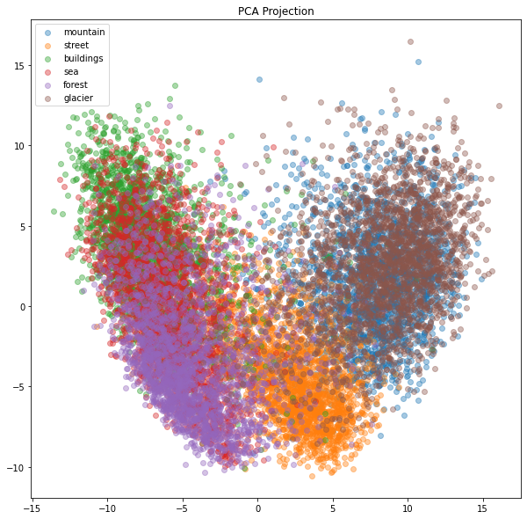
PCA projection

Slide 27
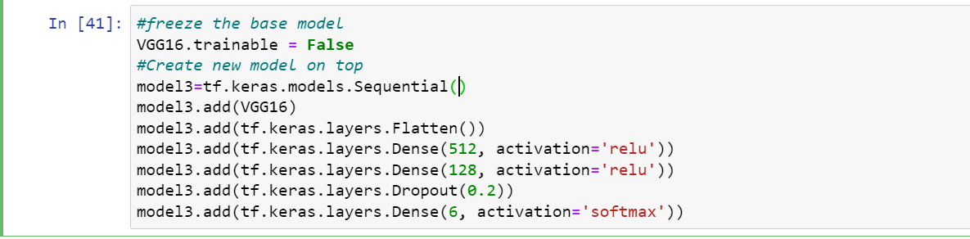
VGG16 architecture

Slide 28
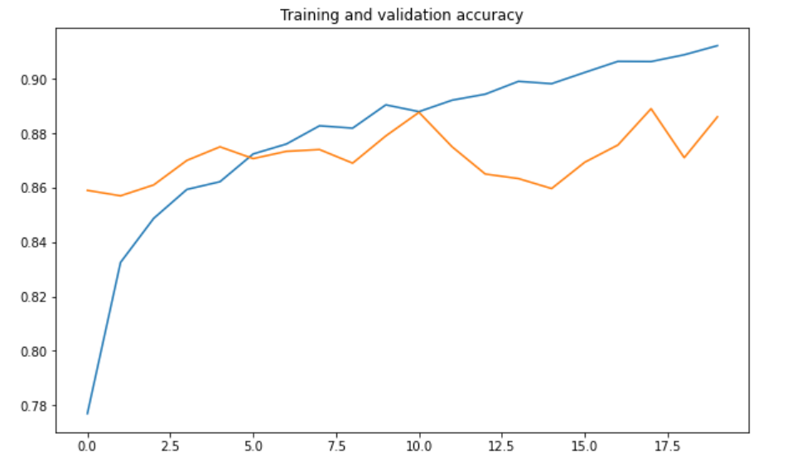
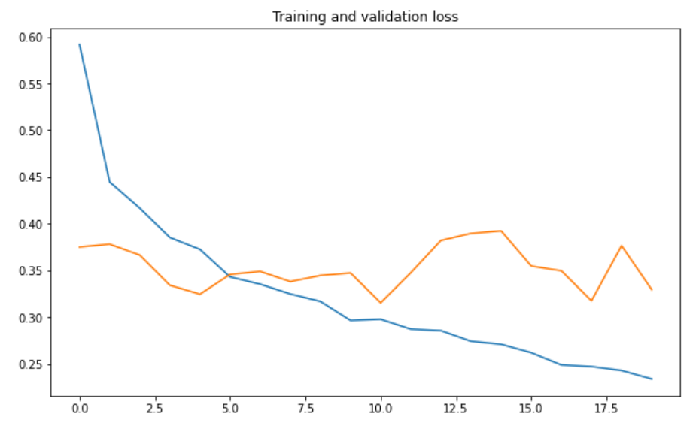
Model evaluation

Slide 29
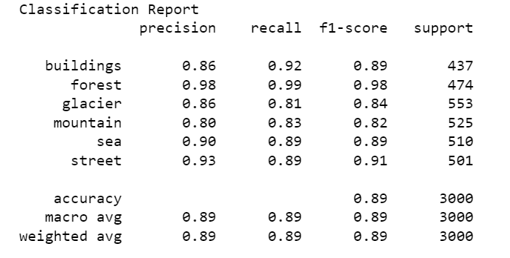
model evaluation

Slide 30
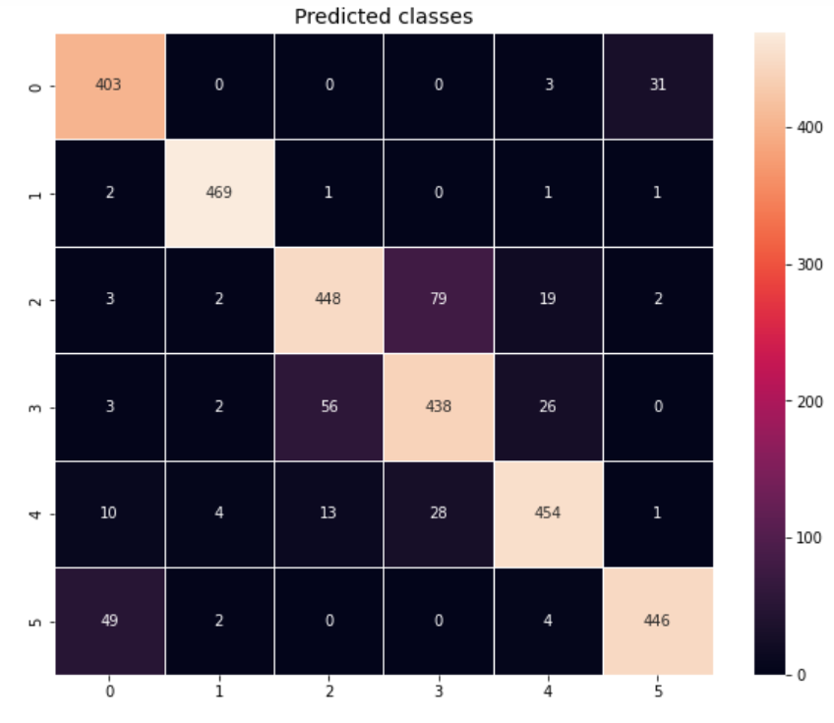
model evaluation

Slide 31
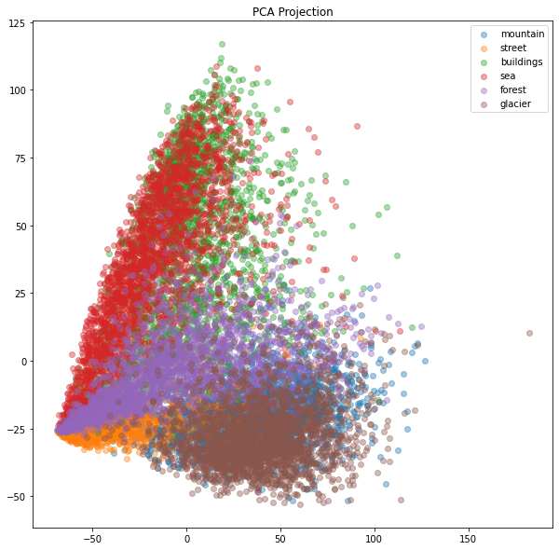
transfer learning (inception v3)

Slide 32
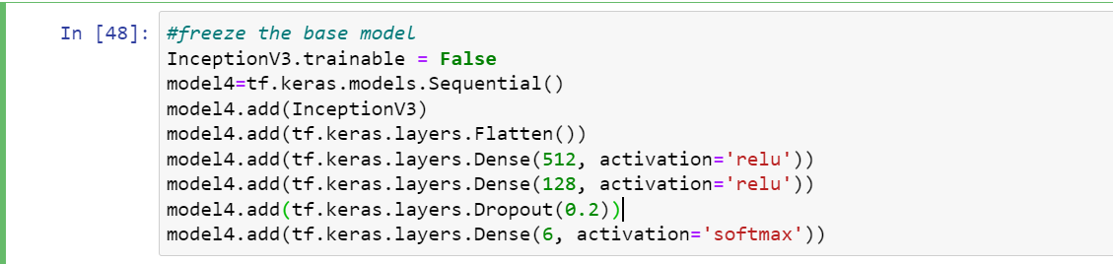
inceptionv3 architecture

Slide 33
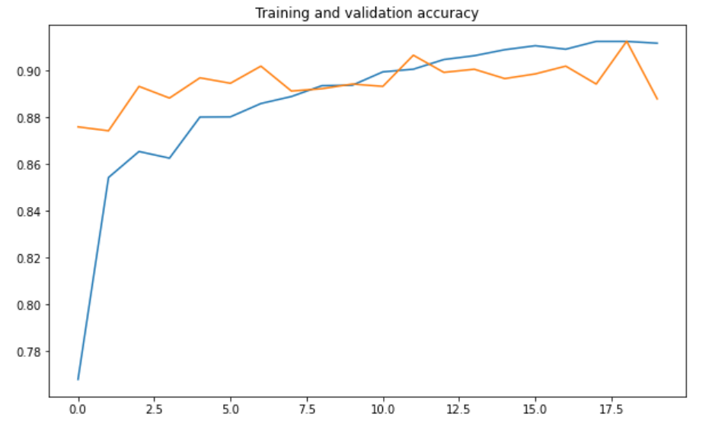
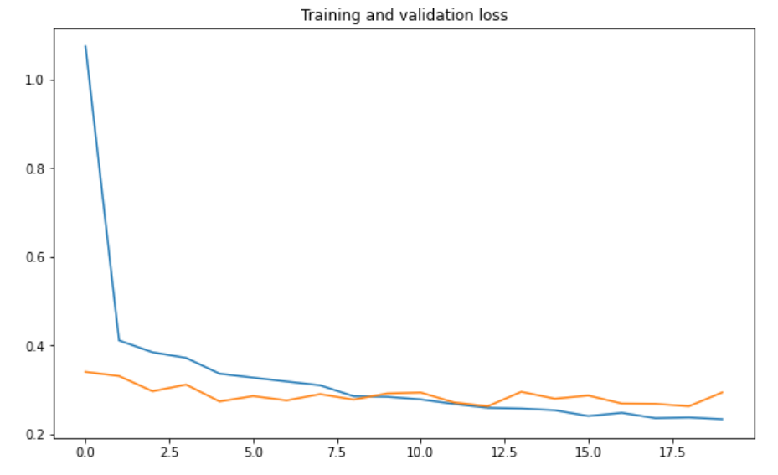
model evaluation

Slide 34
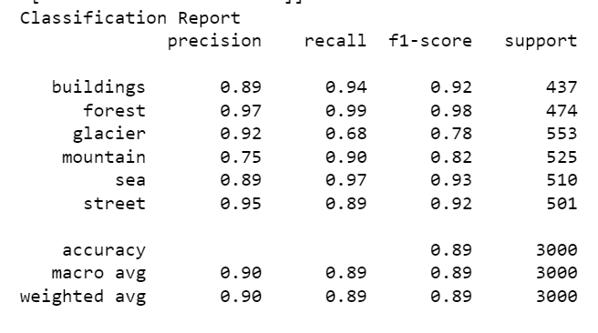
model evaluation

Slide 35
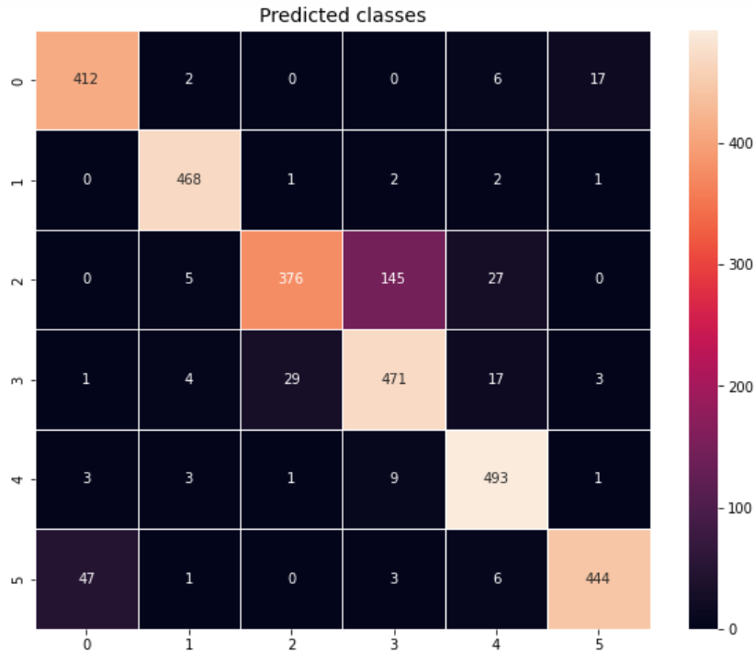
model evaluation

Slide 36
summary
 | CNN | Reg CNN | VGG16 | InceptionV3
Accuracy | 0.89 | 0.90 | 0.91 | 0.91
Val Accuracy | 0.86 | 0.84 | 0.89 | 0.89
Train Loss | 0.27 | 0.29 | 0.23 | 0.24
Val Loss | 0.47 | 0.50 | 0.33 | 0.29

Slide 37
Q&a
Comments?
Feedback?

Slide 38
THANK YOU!

